Slide 1
Differences Between Relational and Non-Relational Databases
Presented by
Alli M. J

Slide 2

CONTENT
Introduction to Databases
Relational Databases
Non-Relational Databases
Characteristics of Relational Databases
Characteristics of Non-Relational Databases
Use Cases for Relational Databases
Use Cases for Non-Relational Databases
Advantages of Relational Databases
Advantages of Non-Relational Databases
Relational vs. Non-Relational: Key Differences
Choosing the Right Database
Conclusion
References

Slide 3
INTRODUCTION
Databases are the backbone of modern applications, storing and managing data for everything from small websites to large-scale enterprise systems.
Understanding the differences between relational and non-relational databases is crucial for choosing the right technology for your projects.

Slide 4
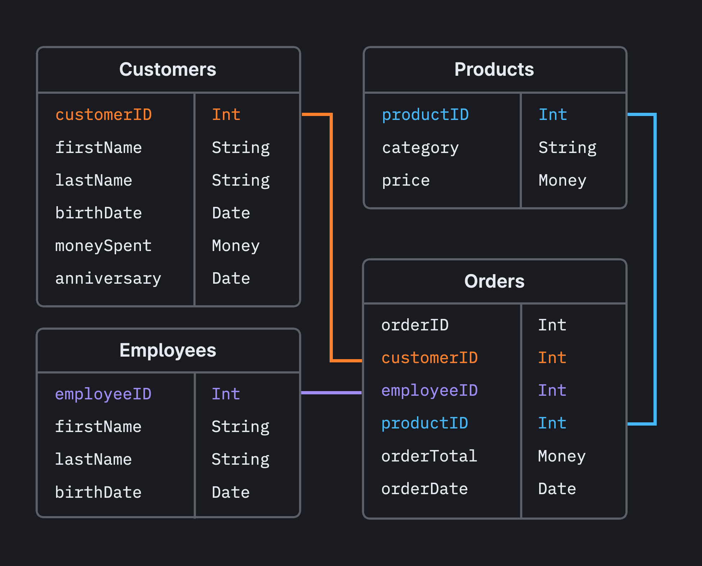
Overview of Relational Databases
Definition: Relational databases store data in tables, where each table represents a collection of related data.
Structure: Data is organized into rows and columns, with each row representing a record and each column representing an attribute.
Query Language: SQL (Structured Query Language) is used to query and manipulate relational databases.
Example: A customer database with tables for customers, orders, and products.

Slide 5

Characteristics of Relational Databases
ACID Compliance: Ensures reliable transactions (Atomicity, Consistency, Isolation, Durability).
Structured Schema: Requires predefined schema, making it ideal for structured data.
Data Integrity: Enforces data integrity through constraints like primary keys and foreign keys.

Slide 6
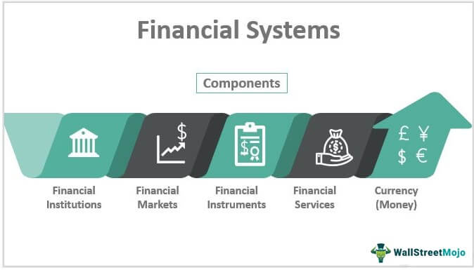

Use Cases for Relational Databases
Financial Systems: Require high data integrity and ACID compliance for transactions.
Inventory Management: Structured data with predefined relationships between entities.
Customer Relationship Management (CRM): Manages structured customer data with complex queries.

Slide 7
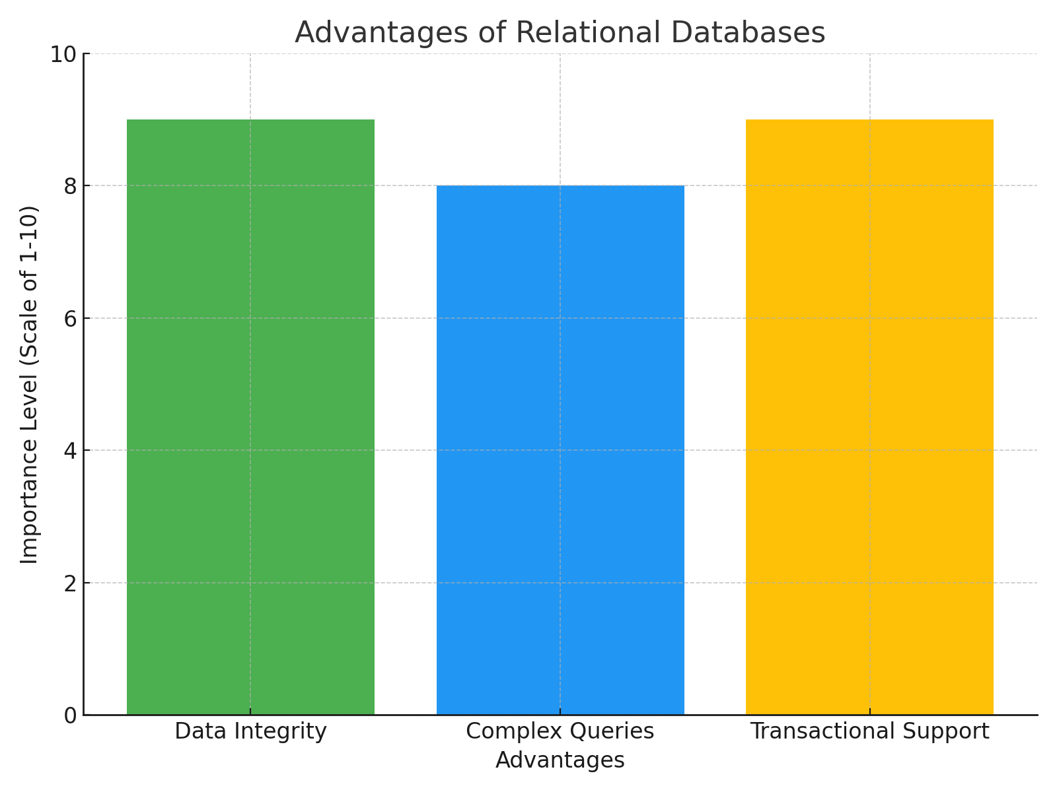
Advantages of Relational Databases
Data Integrity: Enforces consistency and accuracy through constraints and relationships.
Complex Queries: Supports complex SQL queries for data retrieval and manipulation.
Transactional Support: Ensures reliable and consistent transactions.

Slide 8
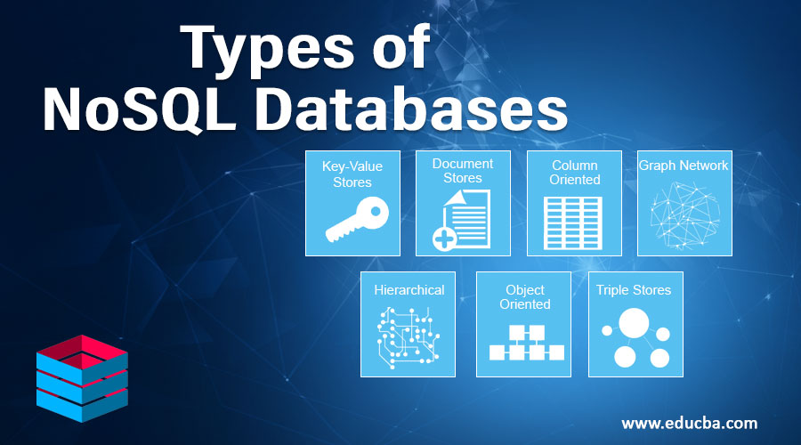
Overview of Non-Relational Databases
Definition:
Non-relational databases, often referred to as NoSQL databases, store data in various formats (document, key-value, column-family, graph)
Data Models:
Document-Based: Stores data as JSON or BSON documents (e.g., MongoDB).
Key-Value Stores: Simple key-value pairs (e.g., Redis).
Column-Family Stores: Data is stored in columns rather than rows (e.g., Cassandra).
Graph Databases: Stores relationships between data entities (e.g., Neo4j).

Slide 9
Use Cases for Non-Relational Databases
Real-Time Analytics:
SOCIAL NETWORKS:
Content Management Systems (CMS):
Handles large volumes of data with high write throughput (e.g., Apache Cassandra for analytics).
Manages complex relationships between users and content (e.g., Neo4j for graph-based data).
Stores and manages unstructured or semi-structured data (e.g., MongoDB for CMS).

Slide 10
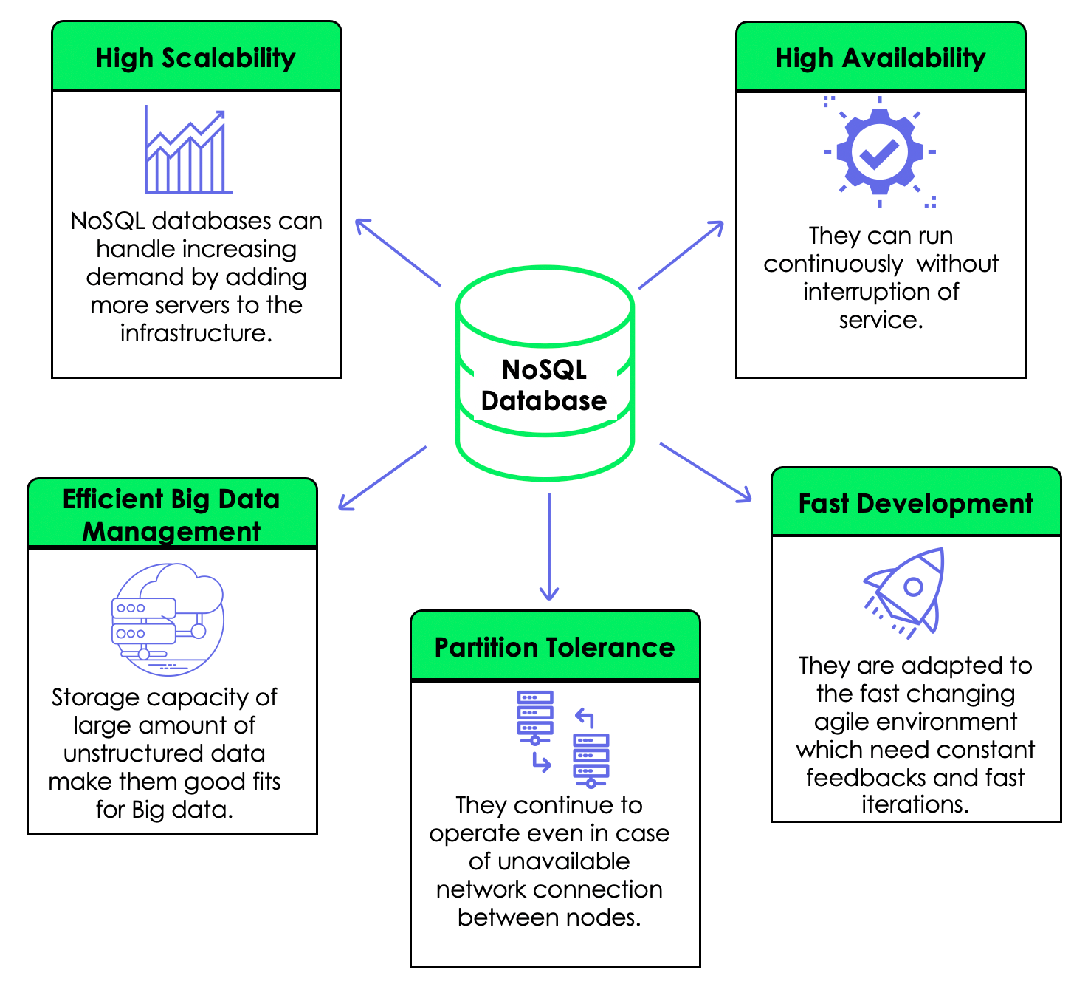
Characteristics of Non-Relational Databases
Schema Flexibility: Does not require a predefined schema, allowing for easy changes.
Eventual Consistency: Prioritizes availability and partition tolerance over immediate consistency.
Scalability: Easily scales horizontally by adding more servers.
​

Slide 11
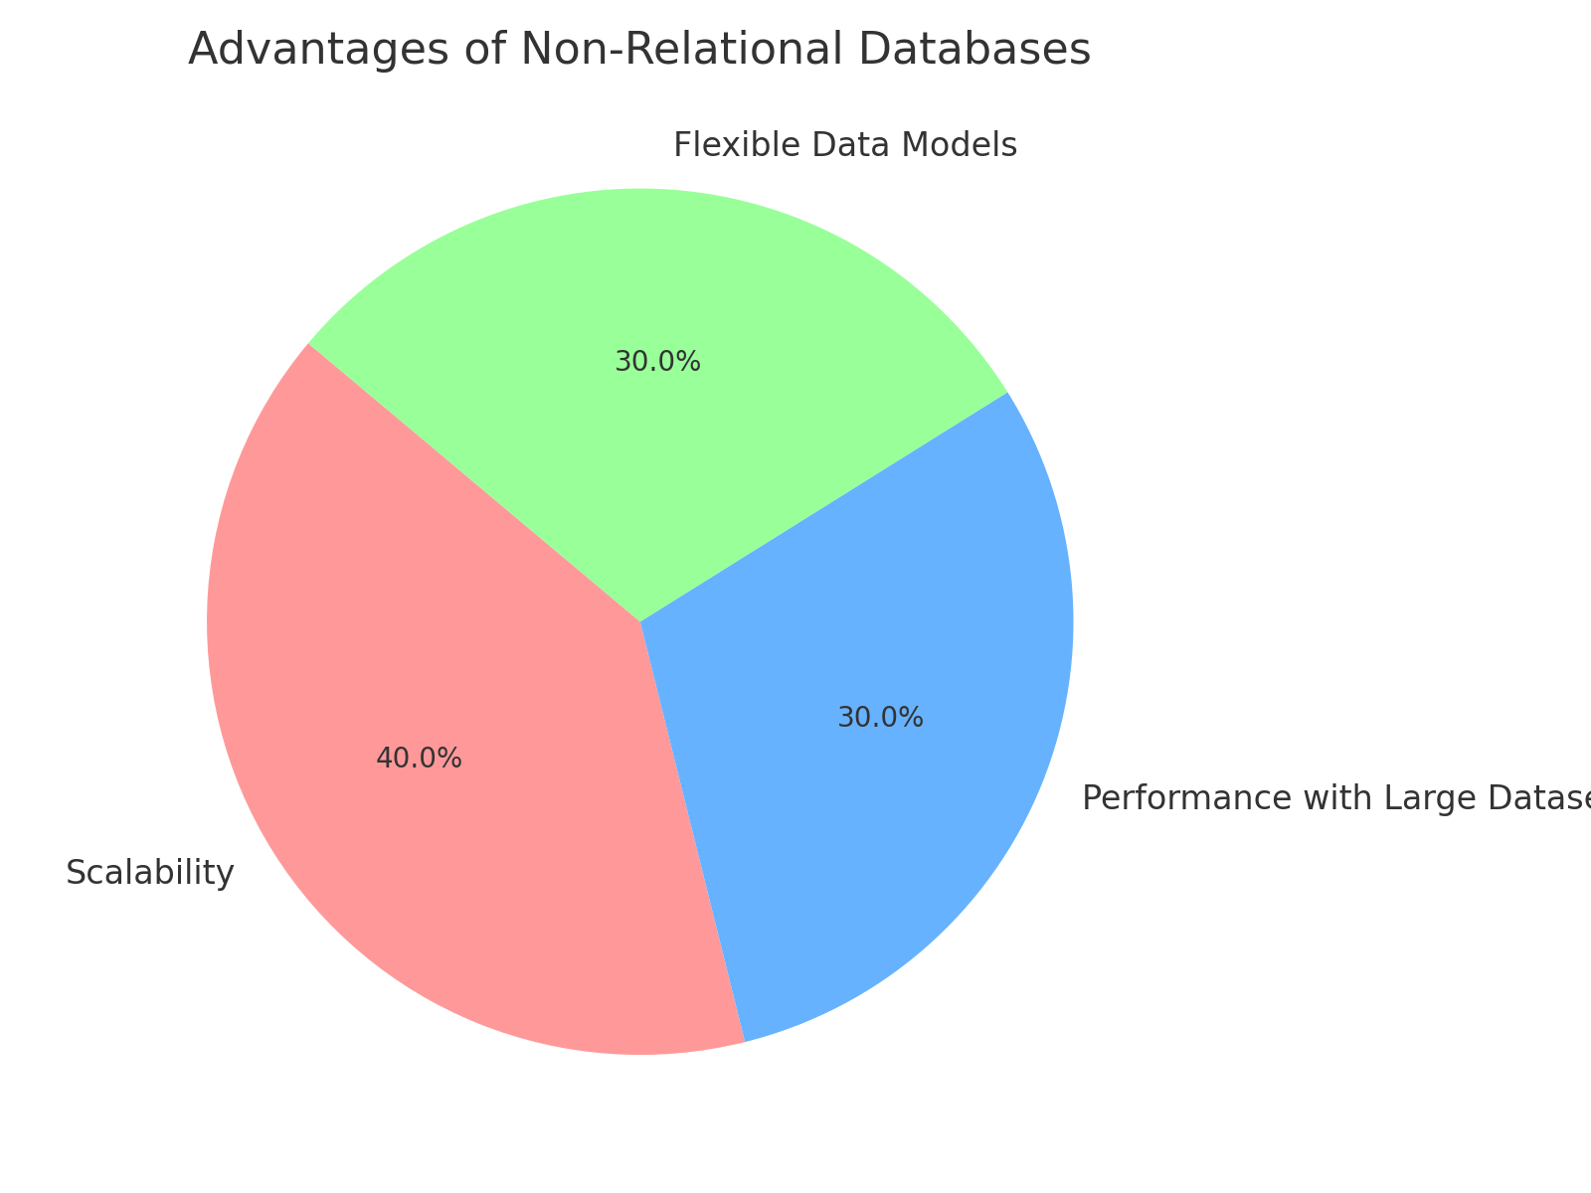
Advantages of Non-Relational Databases
Scalability: Can handle large volumes of data and traffic by distributing across many servers.
Performance with Large Datasets: Optimized for high-performance reads and writes.
Flexible Data Models: Supports various data types and structures, making it suitable for diverse applications.

Slide 12
When to Use Relational vs. Non-Relational Databases
Relational: Best for applications requiring structured data, complex queries, and strong consistency (e.g., financial applications).
Non-Relational: Suitable for applications with large-scale, unstructured data and high scalability requirements (e.g., big data, social networks).

Slide 13


Real-World Examples
Relational Database Example: Amazon uses Oracle for structured transactions.
Non-Relational Database Example: Facebook uses Apache Cassandra for real-time analytics.
Amazon web service​​
FACEBOOK
IBM Db2​​
oracle ​​
AWS offers a variety of database services, including Amazon RDS (Relational Database Service) for relational databases like MySQL, PostgreSQL, and Oracle.
IBM Db2 is a family of data management products, including a relational database with AI-driven capabilities for managing structured and unstructured data. It's often used in large-scale enterprise environments, especially in industries like finance and healthcare.
Azure supports both relational and non-relational databases.

Slide 14
Challenges and Considerations
Data Migration: Moving data between relational and non-relational databases can be complex.
Management Complexity: Non-relational databases may require more expertise in managing distributed systems.
Vendor Lock-In: Proprietary databases may limit flexibility in switching technologies.

Slide 15
Conclusion & Additional Resources
Summary: Relational and non-relational databases each have their strengths and are suited to different use cases. Understanding their characteristics, advantages, and use cases is crucial for making informed decisions.
Resources:
"Database System Concepts" by Silberschatz, Korth, and Sudarshan
"NoSQL Distilled" by Sadalage and Fowler
Online courses and tutorials on SQL and NoSQL databases.

Slide 16
References
Silberschatz, A., Korth, H. F., & Sudarshan, S. (2010). Database System Concepts (6th ed.). McGraw-Hill.
Ramakrishnan, R., & Gehrke, J. (2003). Database Management Systems (3rd ed.). McGraw-Hill.
Date, C. J. (2011). SQL & Relational Theory: How to Write Accurate SQL Code (2nd ed.). O'Reilly Media.
Sadalage, P. J., & Fowler, M. (2012). NoSQL Distilled: A Brief Guide to the Emerging World of Polyglot Persistence. Addison-Wesley.Available at: Link
Kleppmann, M. (2017). Designing Data-Intensive Applications. O'Reilly Media.

